Slide 1




NEXT GEN EMPLOYABILITY PROGRAM
Creating a future-ready workforce
Team Members
College Name: ANNAI MIRA COLLEGE OF ENGINEERING AND TECHNOLOGY
Student Name :PRAVEEN KUMAR S
Student ID :513521243303

Slide 2

CAPSTONE PROJECT SHOWCASE
Project Title
Building Bus Reservation System using Python and Django
Abstract | Problem Statement | Project Overview | Proposed Solution | Technology Used | Modelling & Results | Conclusion

Slide 3
Abstract
Passenger Information:Collect essential details like name, contact information, and number of passengers.Hide complex backend processes like data validation and storage mechanisms.Seat Reservation Abstraction:Allow passengers to select seats without knowing the underlying seat allocation algorithm.Handle seat availability and booking status internally.Payment Abstraction:Provide a payment interface where users enter payment details.Abstract away payment gateway integration and transaction handling complexities.Admin Dashboard Abstraction:Show key metrics like total bookings, revenue, and seat occupancy without revealing backend data processing.Notification Abstraction:Send booking confirmation and updatesto passengers without exposing the underlying messaging system.By implementing these abstractions, users can interact with the bus reservation system intuitively, focusing on their booking needs rather than system intricacies
Source :

Slide 4
Problem Statement
Design and develop a bus reservation system that allows users to search for bus routes, view available seats, make bookings, and manage their reservations. The system should have an admin interface for managing buses, routes, and bookings. Users should be able to register, log in, search for buses based on source and destination, select seats, make payments, and receive booking confirmations. Admins should be able to add/edit/delete buses and routes, view bookings, and generate reports. The system should handle multiple users and ensure data security and integrity.
Source :

Slide 5
Project Overview
1.Mention the purpose of the system and its target users (customers, admins, etc.).
2. Objectives:List the primary objectives of the bus reservation system.Include specific goals such as enabling easy booking, efficient seat management, secure payment processing, etc.
3. Features:Describe the key features of the bus reservation system in detail.Include functionalities like user registration/login, bus route search, seat selection, payment processing, booking confirmation, admin dashboard, etc.
4. Architecture:Explain the system architecture, including components like front-end, back-end, database, APIs, etc.Mention technologies and frameworks used for development (e.g., React.js for front-end, Node.js for back-end, MongoDB for database).
5. User Roles:Define different user roles (customer, admin) and their respective permissions.Specify actions and operations each role can perform within the system.
6. Workflow:Provide a step-by-step workflow of the bus reservation process for users (booking a ticket, managing bookings, cancellations, etc.).Include flowcharts or diagrams for better understanding.
Source :

Slide 6
Proposed Solution
.
Develop a user-friendly web/mobile interface with intuitive search options and secure authentication, alongside an admin panel for route management and seat allocation. Integrate real-time updates, payment gateways, and booking management features, coupled with notifications and reminders for users. Utilize a comprehensive admin dashboard for analytics and reporting, ensuring data security, scalability, and performance optimization. Continuously gather feedback and prioritize improvements to enhance the user experience and system functionality.
Source :

Slide 7
OBJECTIVES:
The objective of a bus reservation system is to automate and streamline the booking process, improving efficiency and accuracy while providing passengers with a convenient and user-friendly platform to reserve seats, manage bookings, and check availability. Additionally, it aims to enhance operational management for bus companies by optimizing resource allocation and maximizing revenue potential.
Source :

Slide 8


Technology Used
Front-end
Back-end
Source :

Slide 9
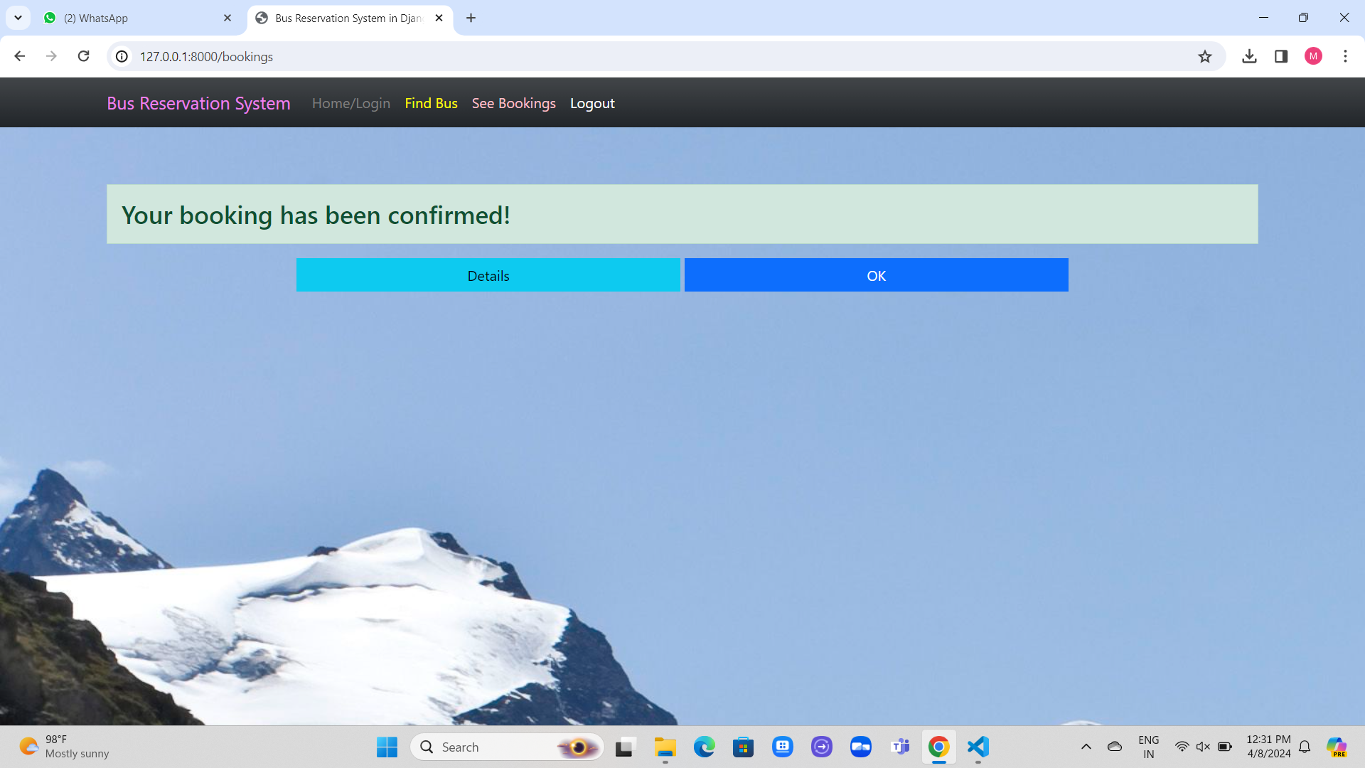
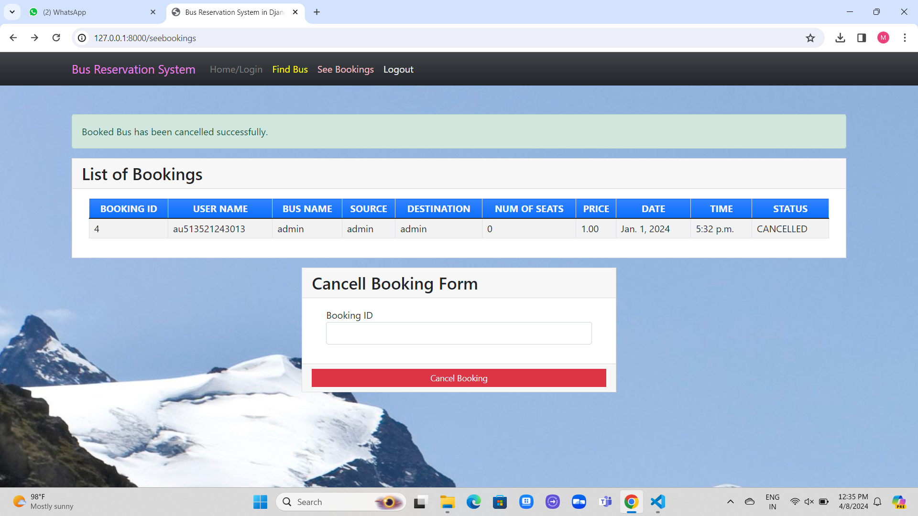
Modelling & Results
Source :

Slide 10
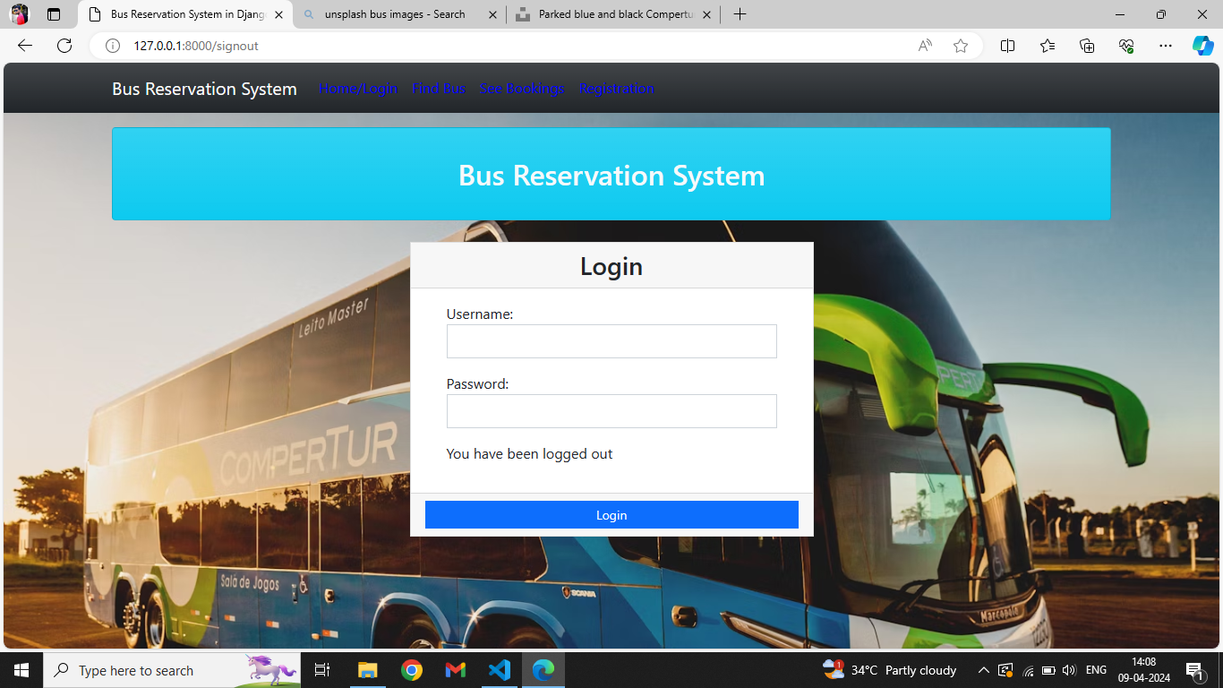
Source :

Slide 11
Homepage

Slide 12
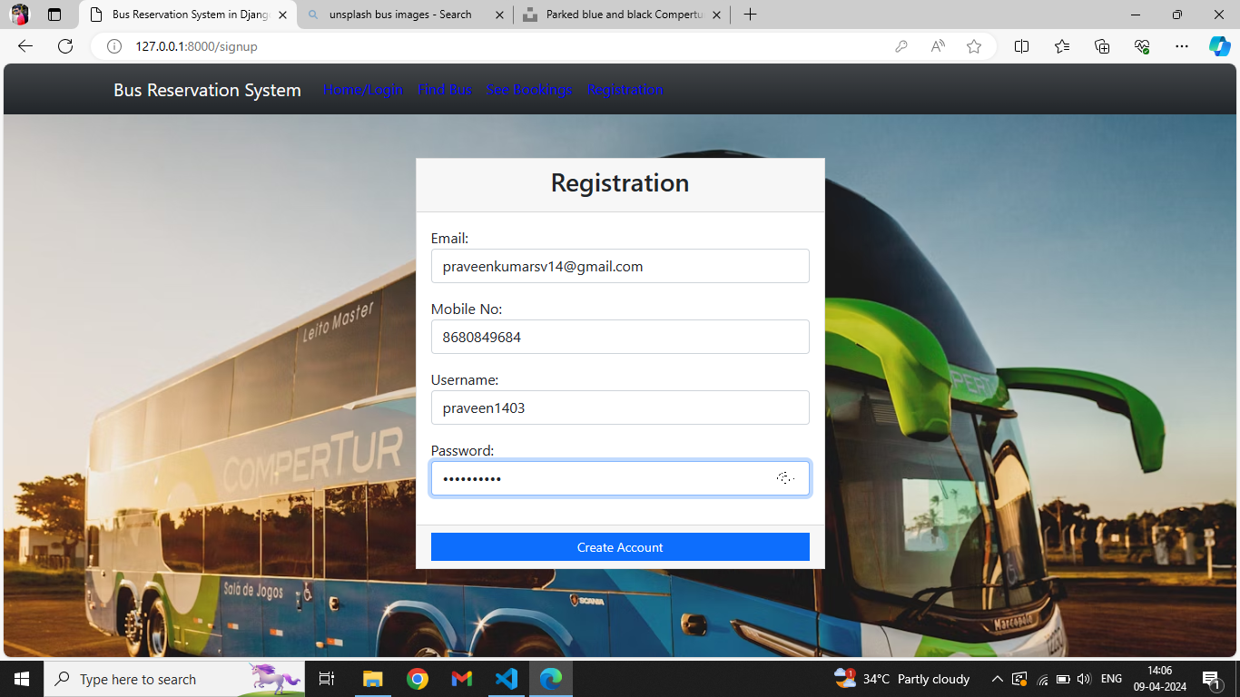
NEW USER REGISTRATION

Slide 13
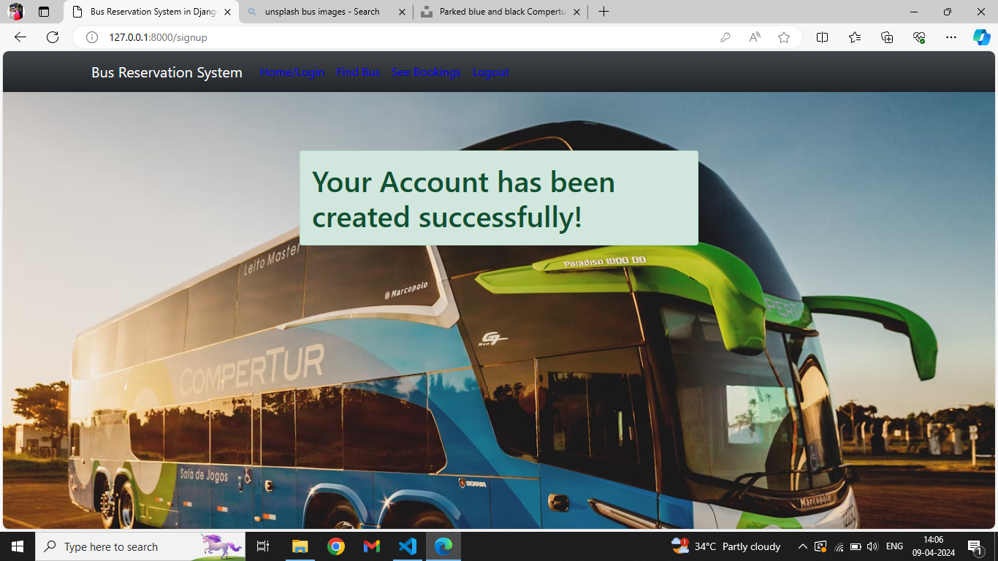
Registration Successfull

Slide 14
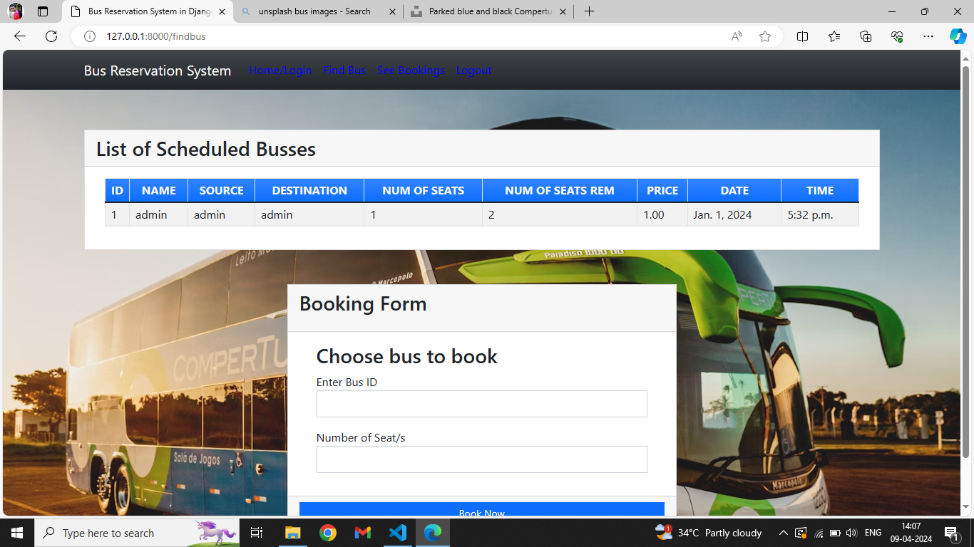
FIND BUS

Slide 15
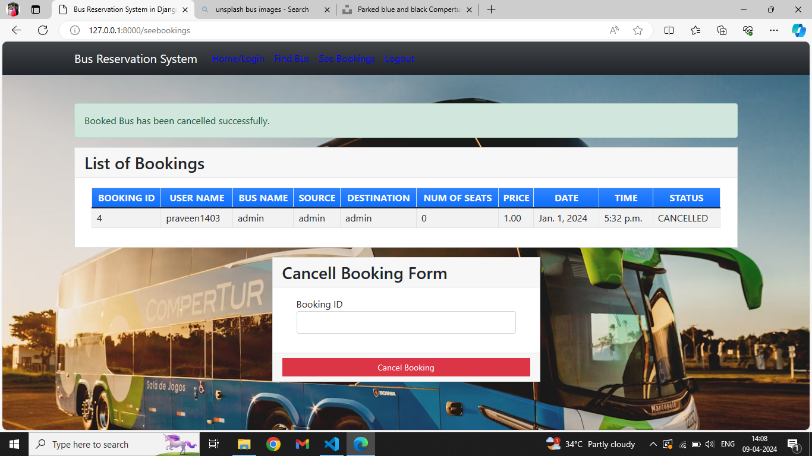
BOOKING CANCELLING

Slide 16
Future Enhancements:
Future enhancements for a bus reservation system could include integrating real-time tracking and monitoring functionalities for buses, implementing dynamic pricing algorithms based on demand and availability, and incorporating AI-driven predictive analytics for optimized route planning and scheduling, ultimately enhancing efficiency and passenger satisfaction.

Slide 17
Conclusion
A well-designed bus reservation system streamlines the booking process, enhances operational efficiency, and improves customer experience by providing easy access to available seats and enabling hassle-free reservations and cancellations. Its implementation not only optimizes resource allocation but also fosters customer loyalty through seamless service delivery.
Source :

Slide 18
Thank You!
Notes:
Thank You !!

